Slide 1
Estimating QoS with ML Filip Krasniqi, Jocelyne Elias and Jérémie Leguay 17/07/2019

Slide 2
Introduction
Estimating QoS is a hard problem
The space exploration is composed of a lot of parameters: topology, number of nodes, routing policy, traffic intensity, traffic distribution…
It means that we are learning the relation between the QoS metrics and all these features!
About Machine Learning
Supervised Learning problem - Regression
We choose Deep Learning (DL) as the Machine Learning family
Most of these features are not even easy to describe in a way s.t. DL techniques can handle with them
Notes:
Remind you that problem statement is: is it feasible to estimate QoS metrics applying machine learning?
Our attempt: answer this question, comparing it with SoA techniques and trying to adapt ML SoA techniques (guess: DL is better)
Criticalities:
Complex relation between QoS metrics and lot of features
Not easy to represent: When applying ML you need to represent features in a useful way for learning, providing the right information the feature should give. Nevertheless, you must consider recurrent problems (overfitting, performances, …)

Slide 3
Summary 28/05 and updates
Summary 28/05
SoA
Understanding NN ⁽¹⁾
DeepQ ⁽²⁾
RouteNet ⁽³⁾
Dataset analysis
Goal: exploit their work to improve the collection of data for a real case scenario
Implementation of ⁽¹⁾
Learning from their dataset
Goal: exploit results obtained in this phase when learning from our dataset
Updates 17/07
Simulations
Goal: have a tool that allows to easily build useful datasets for different network topologies and in different traffic regimes
Targets: per link delay, e2e delay, per link load
Features: traffic matrix, dropped packets, some link properties (capacity, queue size), routing scheme
Final implementation: generate_simulations.py, simulation.cc, build_dataset.py
Details: delay is measured as [s/bit], load as [bit/s]
Learning
Goal: apply same ML technique described in UnderstandingNN paper.
Learn f s.t. D= f(T), being D = e2e delay, T = traffic matrix. Evaluate generalization capabilities.
Notes:
28/05:
SoA
Analysis of their datasets
Implementation of model in Understanding NN
Our efforts:
Improve data
Improve model. Among proposals: apply GCN, Graph Neural Network, mix RouteNet and DeepQ, understand criticalities of RouteNet where it is not clear
17/07
Simulations -> hard focus to provide hints for future works and to ask for suggestions
Description of goal
Identification of targets and features
Further work: adapt those in learning and understand which are relevant when estimating
Final implementation
Learning
Application of NN as did on their dataset to
understand effectiveness = generalization when learning from training and test
Compare behavior with previous approach to understand quality of data (not final)
Distinction between topology and link properties

Slide 4
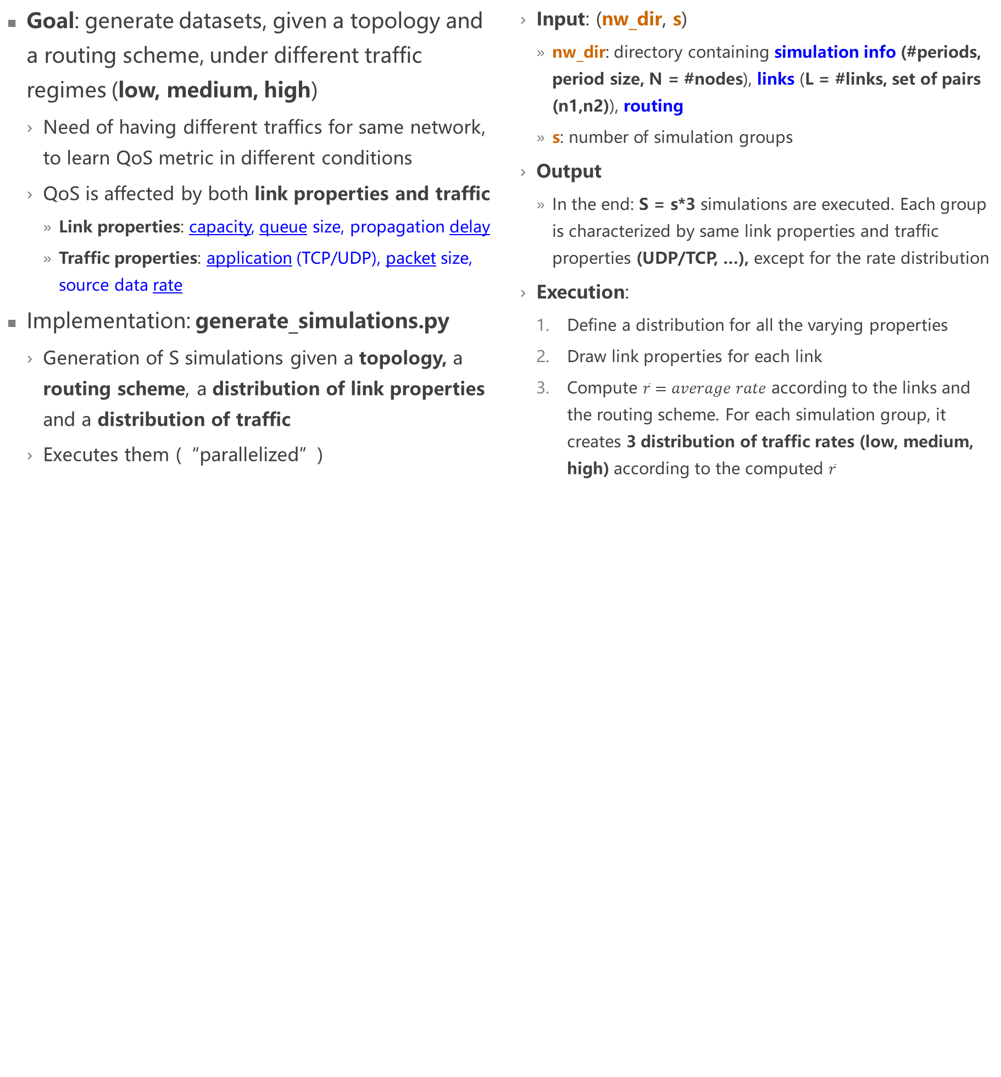
Step 1: Generate simulations (1/2)
Goal: generate datasets, given a topology and a routing scheme, under different traffic regimes (low, medium, high)
Need of having different traffics for same network, to learn QoS metric in different conditions
QoS is affected by both link properties and traffic
Link properties: capacity, queue size, propagation delay
Traffic properties: application (TCP/UDP), packet size, source data rate
Implementation: generate_simulations.py
Generation of S simulations given a topology, a routing scheme, a distribution of link properties and a distribution of traffic
Executes them (“parallelized”)
Input: (nw_dir, s)
nw_dir: directory containing simulation info (#periods, period size, N = #nodes), links (L = #links, set of pairs (n1,n2)), routing
s: number of simulation groups
Output
In the end: S = s*3 simulations are executed. Each group is characterized by same link properties and traffic properties (UDP/TCP, …), except for the rate distribution
Execution:
Define a distribution for all the varying properties
Draw link properties for each link
Compute $\overline{r}=average rate$ according to the links and the routing scheme. For each simulation group, it creates 3 distribution of traffic rates (low, medium, high) according to the computed $\overline{r}$
Notes:
Description of goal
Description of regimes
Description of space of exploration -> features to generate different datasets
Fix properties
Vary for same properties 3 regimes -> enough randomness induced when generating more simulations, this approach allows us also to compare the three regimes
Implementation

Slide 5
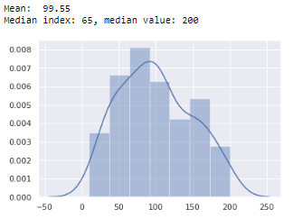
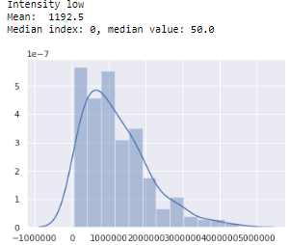
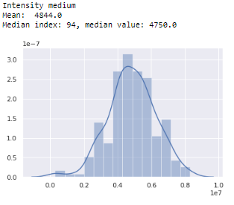
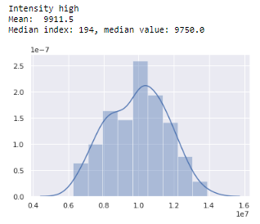
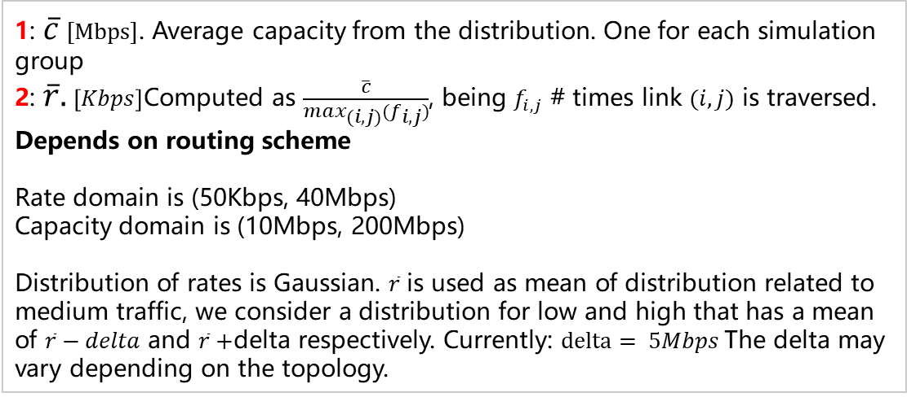
Step 1: Generate simulations (2/2): example
1
1: $\overline{c}$ $[Mbps]$. Average capacity from the distribution. One for each simulation group
2: $\overline{r}.$ $\left[Kbps\right]$Computed as $\frac{\overline{c}}{\max_{(i,j)}(f_{i,j})}$, being $f_{i,j}$ # times link $(i,j)$ is traversed. Depends on routing scheme
Rate domain is (50Kbps, 40Mbps)
Capacity domain is (10Mbps, 200Mbps)
Distribution of rates is Gaussian. $\overline{r}$ is used as mean of distribution related to medium traffic, we consider a distribution for low and high that has a mean of $\overline{r}−delta$ and $\overline{r}+$delta respectively. Currently: $delta= 5Mbps$The delta may vary depending on the topology.
2

Slide 6
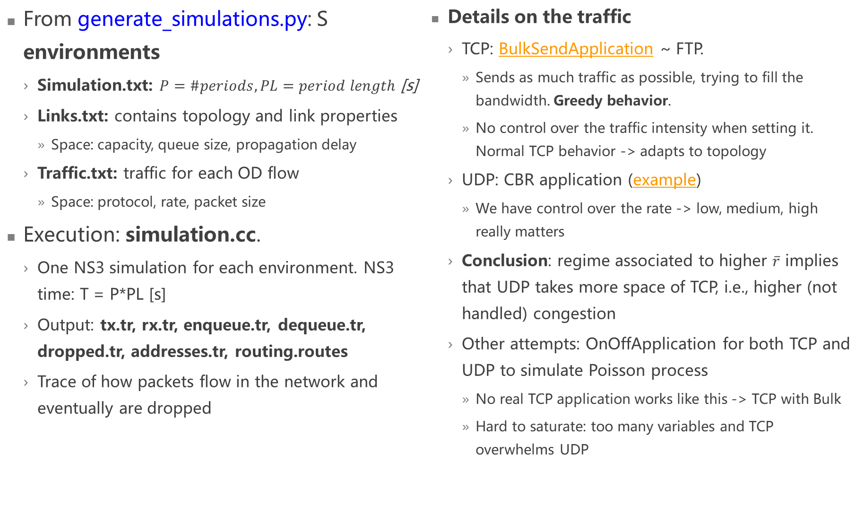
Step 2: Simulation execution
From generate_simulations.py: S environments
Simulation.txt: $P=\#periods, PL=period length$ [s]
Links.txt: contains topology and link properties
Space: capacity, queue size, propagation delay
Traffic.txt: traffic for each OD flow
Space: protocol, rate, packet size
Execution: simulation.cc.
One NS3 simulation for each environment. NS3 time: T = P*PL [s]
Output: tx.tr, rx.tr, enqueue.tr, dequeue.tr, dropped.tr, addresses.tr, routing.routes
Trace of how packets flow in the network and eventually are dropped
Details on the traffic
TCP: BulkSendApplication ~ FTP.
Sends as much traffic as possible, trying to fill the bandwidth. Greedy behavior.
No control over the traffic intensity when setting it. Normal TCP behavior -> adapts to topology
UDP: CBR application (example)
We have control over the rate -> low, medium, high really matters
Conclusion: regime associated to higher $\overline{r}$ implies that UDP takes more space of TCP, i.e., higher (not handled) congestion
Other attempts: OnOffApplication for both TCP and UDP to simulate Poisson process
No real TCP application works like this -> TCP with Bulk
Hard to saturate: too many variables and TCP overwhelms UDP
Notes:
How generate_simulations is linked with simulation.cc: concept of environment
Utilization of ns3, output as trace files
Details on traffic
TCP
UDP
What led us to this
Comparison of applications: made by drawing the distribution of targets and features
Need to have clear idea of identified features and targets before understanding how simulation works

Slide 7
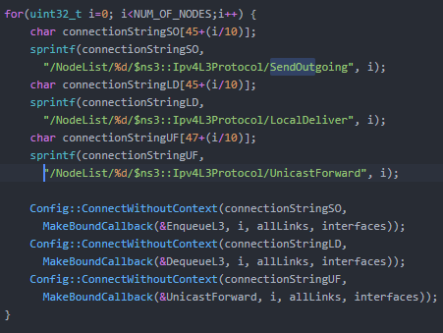
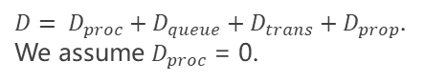
Recognized targets
Per link delay PLD. Matrix NxN.
For each node, we define a trace source on queuing, forwarding and dequeuing. Please refer to SendOutgoing, UnicastForward, LocalDeliver in ns3::Ipv4L3Protocol
Eg: packet p is sent. P1 is packet p on link l1, p2 is p on l2.
0
1
2
Delay on link l1 for p1: t2-t1
Delay on link l2 for p2: t3-t2
l1
l2
$D= D_{proc}+D_{queue}+D_{trans}+D_{prop}$.
We assume $D_{proc}$ = 0.
SendOutgoing: t1
UnicastForward: t2
LocalDeliver: t3
OD flow: (0,2)
End-to-end delay ED. Matrix NxN.
We use same measures as per link delay.
Dataset will be built in a different way, that is, we will not consider the data when origin/destination do not match with current sending / receiving node.
Link loads L. Matrix NxN.
On every link, we define a trace source on the transmission. Please refer to MacTx in ns3::PointToPointNetDevice
Real code to define listeners for per link delay
Notes:
Description of datasets: targets
Details on metrics used to measure delay

Slide 8
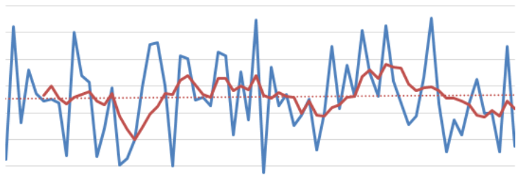
Recognized features
Measurements
Link capacity C. Matrix NxN, being N = #nodes.
Outgoing queue size Q. Matrix NxN.
Traffic matrix T. Matrix NxN.
To be measured. Value defined for each OD pair.
Routing policy R . Matrix N^4.
Dropped packets D. Matrix NxN.
Necessary also to build end to end delay
Some considerations
Values depending on time: T, D. Values fixed for a given topology: all the others
During modeling need to understand whether to consider the two types in the same way
GCN: example of using adjacency matrix to initialize weights differently
How to build dataset
We define a period P
For now, P = 0.1s
For each period, we have an instance of the input features and the associated target
Eg: e2e delay. Goal: learn function f s.t. ED = f(C,Q,T,R,D). Given T obtained averaging the measures over P, D obtained summing all the values during period P, and given C, Q, R we define the target ED by summing all the delays concerning that flow during period P.
-> to have 10 rows, we must run the simulator for an equivalent time of P*10.
By increasing/decreasing the period, we are averaging to smooth the function we want to learn
During modeling, we will try RNN to learn the evolution over time
We will consider which features are actually useful from practicing on the model
Notes:
Description of datasets: potential features
Build datasets by averaging over the period. How I do that it depends on the feature/target

Slide 9
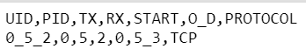
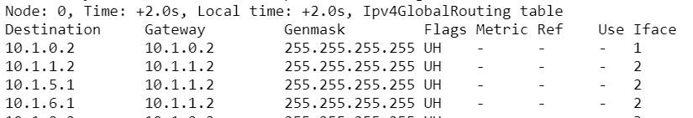
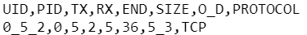
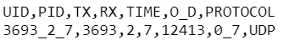
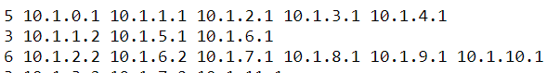
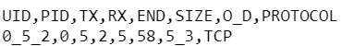
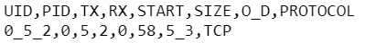
Simulation outputs
Enqueue.tr
A row for each measurement in SendOutgoing or UnicastForward event
Example:
Dequeue.tr
A row for each measurement in UnicastForward or LocalDeliver event
Example:
Dropped.tr
A row for each measurement in RootQueueDiscList/Drop event (TC layer)
Example:
Rx.tr
A row for each measurement in MacRx
Example:
Tx.tr
A row for each measurement in MacTx
Example:
Routing.routes
Output of Ipv4GlobalRoutingHelper::PrintRoutingTableAllAt
Examples:
Addresses.tr
One row for each node. Contains number of addresses and all the addresses for the corresponding node at index I
Examples:
Allows mapping between routing.routes and our way of describing nodes, i.e., with IDs
Details on attributes
PID: packet ID; UID: row global ID in same file = PID_TX_RX
O_D = ORIGIN_DESTINATION
TX = transmitting node, RX = receiving node during O_D flow
START,TIME,END = time of that measurement
Notes:
Now that you have clearer idea of datasets, these are the 7 output files that allow to build the datasets.
On the slide there are details on the trace sources used in ns3 to trace the data

Slide 10
Step 3: build the dataset (1/2)
Need to aggregate all of these raw data to build
traffic matrix, per output queue drop, per link load, per link delay, e2e delay: these are multiple measurements for the same simulation
To be considered in a period p, the START/TIME attribute must be in the corresponding p. don’t care about END (it can be on the next period)
Routing policy, link properties: fixed per simulation
Traffic matrix (TM)
Involved files: tx.tr. The traffic is averaged over each period. So, for each period and for each OD, I sum the traffic that is sent and divide it over the period size [s]. No aggregation required
Result: matrix P x N^2, P = #periods, N = #nodes
Dropped (D)
Involved files: dropped.tr. For each period and for each link, I sum the drops.
Result: matrix P x N^2, P = #periods, N = #nodes
Per link delay (PLD)
Involved files: enqueue.tr, dequeue.tr .
Aggregation: I compute the delay (END-START) from the two different files when UID corresponds
Averaging: for each period and for each link, I sum separately the total amount of bits sent and the total delays. Then, I obtain delay[s/bit]
Result: matrix P x N^2, P = #periods, N = #nodes
E2e delay (e2eD)
Involved files: enqueue.tr, dequeue.tr, dropped.tr.
Aggregation: I filter all those rows in enqueue.tr that have a tx = origin, and that have a corresponding instance in dequeue.tr among those that have rx = destination. I don’t consider those that during the path traversal were dropped. Finally, I compute the delay (END-START) from the two different files when UID corresponds
Averaging: for each period and for each OD, same as per link delay
Result: matrix P x N^2, N = #nodes, P = #periods
Load L
Involved files: tx.tr, rx.tr
Aggregation: I filter all those rows in tx.tr that have a corresponding instance in rx.tr.
Averaging: for each period and for each link, same computation as traffic matrix
Result: matrix P x N^2, N = #nodes, P = #periods

Slide 11
Step 3: build the dataset (2/2)
Routing policy R
Involved files: routing.routes, addresses.tr. P=#periods. N=#nodes.
Addresses.tr is used just to assign node IDs instead of addresses
We assume that the routing is fixed during all the simulation periods.
We have not yet control over the routing; we are using ns3 routing policy Ipv4GlobalRoutingHelper::PopulateRoutingTables (). It works with Dijkstra SPF computation
Result: vector N^4. I will add this to each row in the corresponding dataset
Link properties: capacity C, propagation delay, queue size Q
Involved files: links.txt .
Refer to“Simulation input”slide
Result
Capacity: vector N^2
Queue size: vector N^2. Represents the queue size at Layer 2
Final datasets (depends on target)
Per link load: TM, R, C, Q, L
Per link delay: TM, D, R, C, Q, PLD
End to end delay: TM, R, C, Q, e2eD

Slide 12
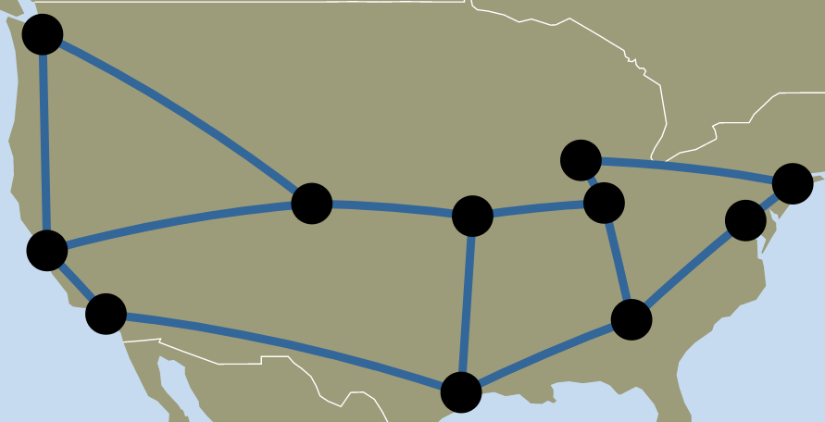
Learning
Networks: Abilene (N = #nodes = 12, L = #links = 15), NSF (N = 14,L = 21), Geant2 (N = 22, L = 36)
Showed results: from Abilene
Sets
Training: 14 simulation groups, 42 simulations, 500 periods
Test: 1 simulation, 500 periods
Fixed intensity when training
Input: traffic matrix
Target: e2e delay
Train model only from low, test with low, medium and high
Model learns from 14*500=7K rows
Results: as expected, when testing on low we have greater results. Need to combine data from low, medium and high
Varying intensity
Input: traffic matrix
Target: e2e delay
N hidden layers, 50 nodes: validation loss = 1.8*10^-4
N^2 hidden layers, 100 nodes: validation loss = 1.7*10^-4
Model (current version):
Deep Learning NN
Optimizer: Adam
Learning rate: 0.0001
L2 regularization. Λ=0.00003
N hidden layers
Sigmoid
Batch normalization
Hidden nodes: 50
Batch size: 256
Early stopping
Max epochs: 2048
Patience: 10
Notes:
Justify that I did not focus much on learning, it would be useful to tune this network and then compare it

Slide 13
Next steps
Short term
Analyze how the model performances are affected when adding the other features we measured
Do some consideration on the relevancy of the features
Per link drops? Sum of drops?
Empirically tune some values to have consistent data (eg: period size)
Try the simple NN model with other computer networks (NSF, Geant2)
Compare DL results with other ML technique (eg: Random Forest) to understand its effectiveness
Long term
Routing scheme in input to the simulator
Update the model considering current state of the art implementations
RouteNet
DeepQ
Apply Graph Convolutional Network

